Slide 1

Similarity Ratio &
Tagging Sentence

Slide 2
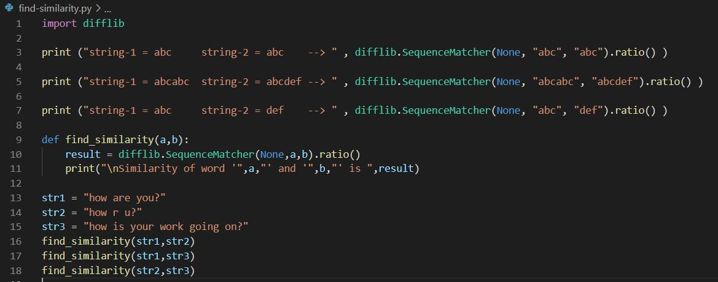
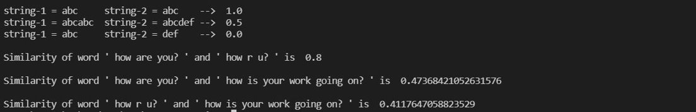
Python Snippet
Output

Slide 3
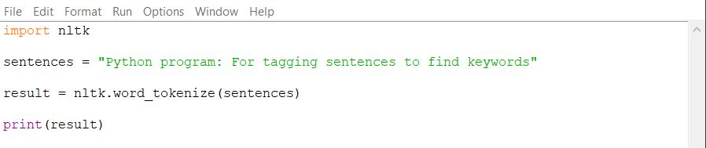
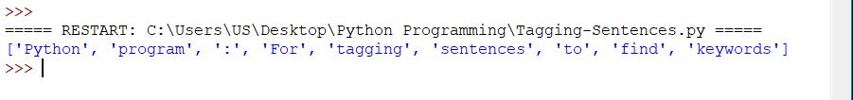
Tagging Sentence to Find Keywords
Python Snippet
Output

